Slide 1
The gem5 Tutorial @HPCA 2024
Presentation by Bobby R. Bruce
Materials designed for gem5 v23.1

Slide 2



A little about me
Started as a Postdoc
In Jan 2021 I moved up to being Project Scientist
Spent almost all that time working on the gem5 project.
Started in Sep. 2019
So, am I an expert in gem5?
2
Notes:
Add Harshil and Ivana here, or just remove this slide.

Slide 3
What is gem5?
The gem5 architecture simulator provides a platform for evaluating computer systems by modeling the behavior of the underlying hardware. It enables researchers to simulate the performance and behavior of complex computer systems, including the CPU, memory system, and interconnects. This makes it possible to study the performance of different microarchitectural and architectural choices, as well as the effects of different workloads, without having to build and test real systems.
By ChatGPT

Slide 4
What are we going to cover today?
A short history of gem5.
Getting gem5 setup on your system: Compilation, etc..
Using prebuilt systems.
An overview of event-based simulation and gem5’s software structure
Simulator outputs and how to interpret it.
Creating a system using stdlib components.
Statistical outputs .
SE-mode and FS-mode simulations.
Checkpoints, lower-fidelity components, KVM mode, and Sampling
Creating your own SimObject.
Creating your own stdlib component.
Gem5 Resources.
How to continue to gem5.
Please feel free to speak up!
Discussion is good!
(I don’t have all the answers though!)

Slide 5



A little bit of history
The GEMS simulator
Provided a detailed memory system.
^{(~2000)}
The m5 Simulator
“A tool for simulating systems”
(~2002)
(2011)
5

Slide 6
A little bit of history
Total Commit*: 21,000
Unique Contributions*: 421
* As of v23.1
6

Slide 7
A true public infrastructure project
Open Source
Free (like beer)
Massively Collaborative
7

Slide 8
Who uses gem5, and why?
Education
Academic Research
Industrial R&D
8

Slide 9
Education
Problem: Students need to learn to design hardware but don’t have a multi-billion-dollar factory
9

Slide 10
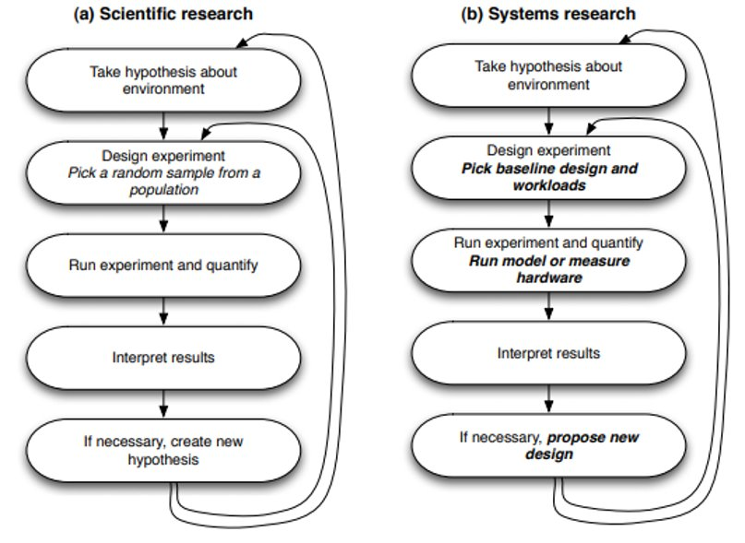
Academic Research
10

Slide 11
Academic Researchers
We surveyed the top architecture conferences and found:
70% of all computer architecture research utilizes simulation.
The gem5 simulator is by-far the most popular.
Room for improvement: Most users still “roll their own” simulation software. Only 20% use gem5 directly. We want to go above 50% by 2027.
11

Slide 12
Industry
?
Really, we don’t know exactly. We don’t track users and industrial users seldom make themselves known.
12

Slide 13



Industry
Big players we know use it
13

Slide 14

Let’s hit the ground running
This example will show:
How someone obtains gem5.
How you build it.
Running a very basic ”Hello World” simulation.
Getting and compiling gem5 is often the hardest part…
There’s a lot of complicated things happening behind the scenes. I will explain them later.
14
Notes:
Add animation here.

Slide 15
Typical Downloading
DON’T DO THIS!
> git clone https://github.com/gem5/gem5
> cd gem5
stable: The default branch for gem5. Updated at stable releases. Currently v23.1.
develop: The branch in which new features, improvements, etc. are added regularly for the next release.
In this tutorial we’re going to use codes paces with a repo which includes some example materials. Though all the gem5 code is v23.1.
15

Slide 16
Using CodeSpaces
Step 1: Go to https://github.com/gem5-hpca-2024/gem5
16

Slide 17
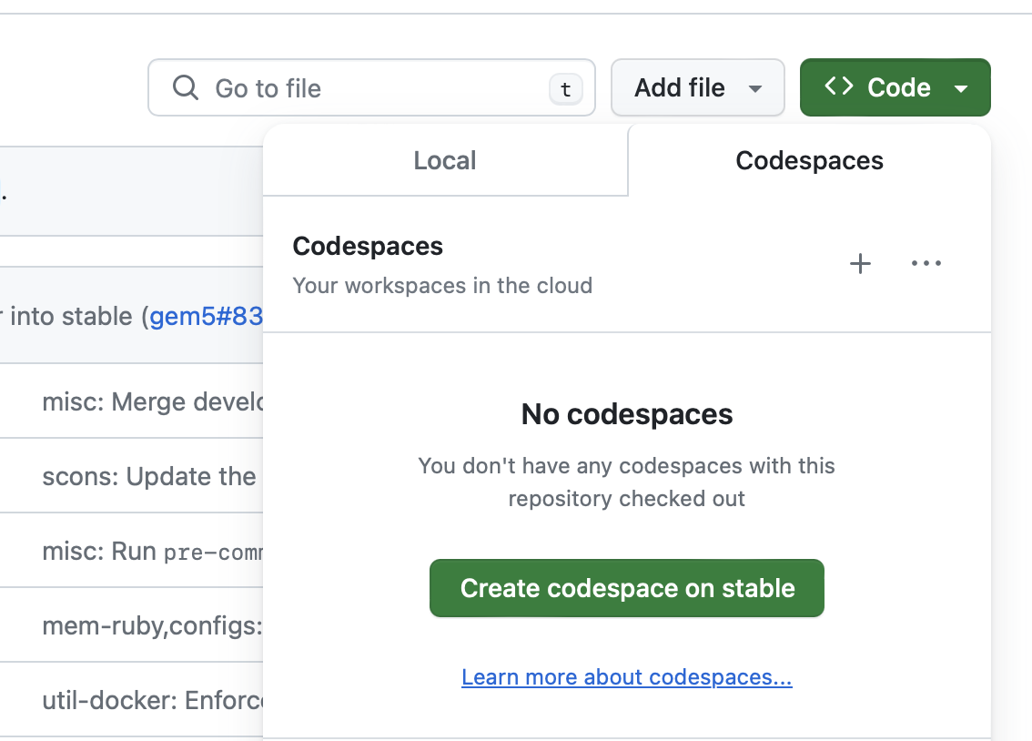
Using CodeSpaces
Step 2: Click “Code” -> ”Create codespace on stable”
Some may be given the option to open this in a local instance of Visual Studio. This is fine. If you receive no option, you’ll run it through the browser. The interface is identical.
17

Slide 18
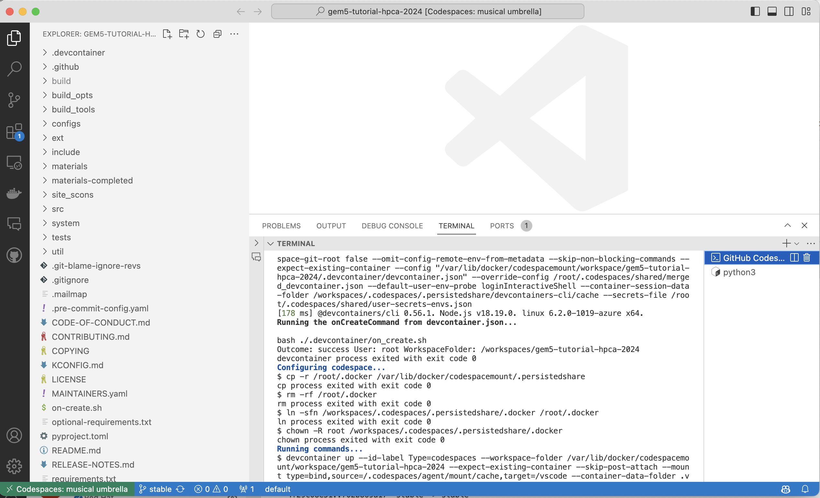
Using CodeSpaces
Step 3: Wait for your environment to load. Then you’re done
18

Slide 19
Building gem5
> scons build/ALL/gem5.opt –j`nproc`
19

Slide 20
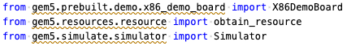
Let’s start by writing a simulation configuration
Open “materials/01-basic.py”. You’ll see the above already prepared for you. Do your work here.
20

Slide 21
Let’s be lazy and use a prebuild board
The X86DemoBoard has the following properties:
Single Channel DDR3, 2GB Memory.
A 4 core 3GHz processor (using gem5’s ‘timing’ model).
A MESI Two Level Cache Hierarchy, with 32kB data and instruction case and a 1MB L2 Cache.
Will be run as a Full-System simulation.
Source: “src/python/gem5/prebuilt/demo/x86_demo_board.py”

Slide 22
Let’s load some software!
(And be lazy again… let’s use something pre-made)
”obtain_resource” downloads the files needed to run the specified workload. In this case the “x86-ubuntu-18.04-boot” workload:
Boots 18.04 with linux 5.4.49
Upon boot will exit the simulation.
https://resources.gem5.org/resources/x86-ubuntu-18.04-boot?version=2.0.0

Slide 23
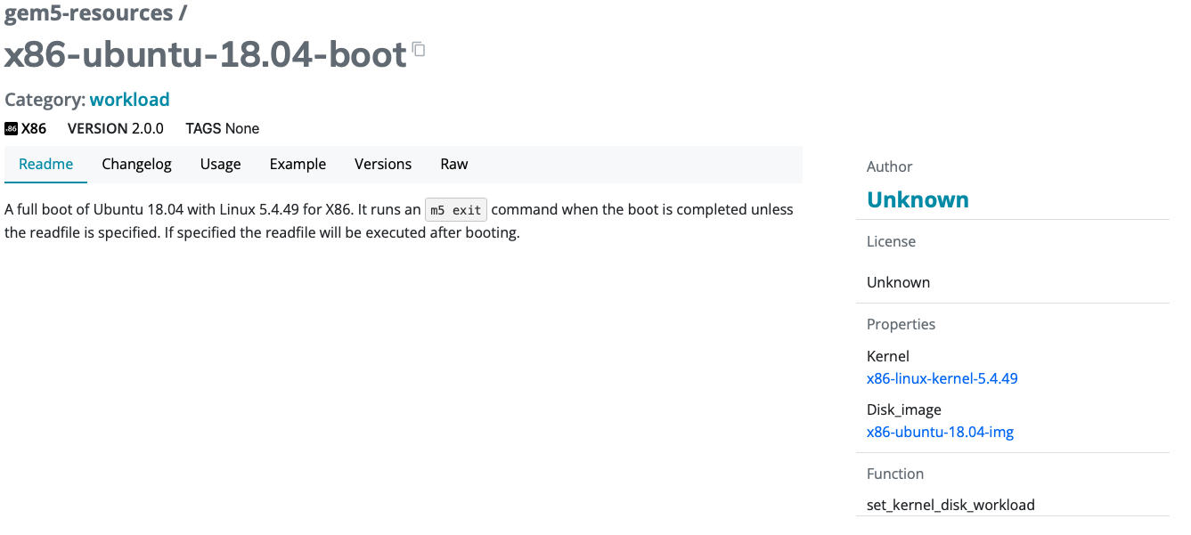
The gem5 Resources Web portal
https://resources.gem5.org/resources/x86-ubuntu-18.04-boot?version=2.0.0

Slide 24
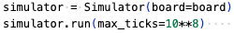
Back to the configuration: Put the board in the simulator
Note: We’re setting “max_ticks” here to stop the simulation after 10 billion simulation ticks. This is just so our simulation stops in a reasonable time `simuator.run()` will have it run to completion.

Slide 25
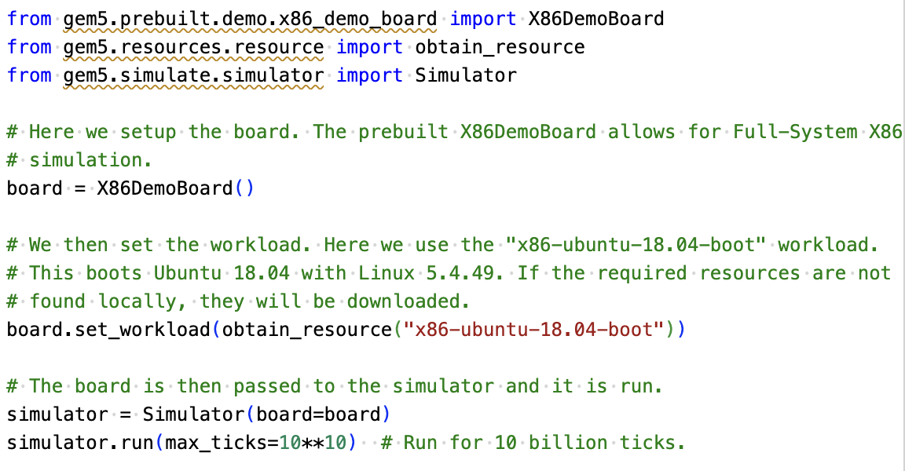
There! We’re done!
The completed configuration can be found in “materials-completed/01-basic.py”

Slide 26
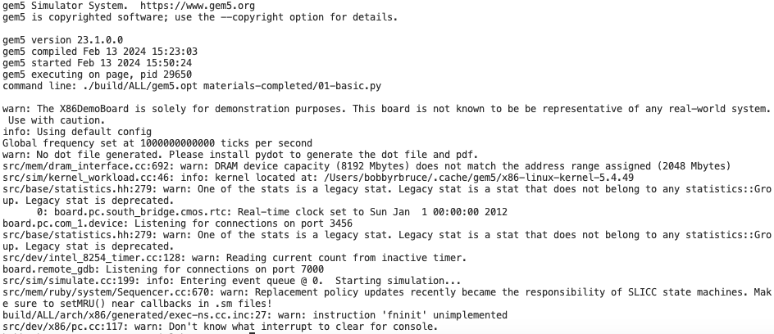
Run the simulation
> ./build/ALL/gem5.opt materials/01-basic.py

Slide 27
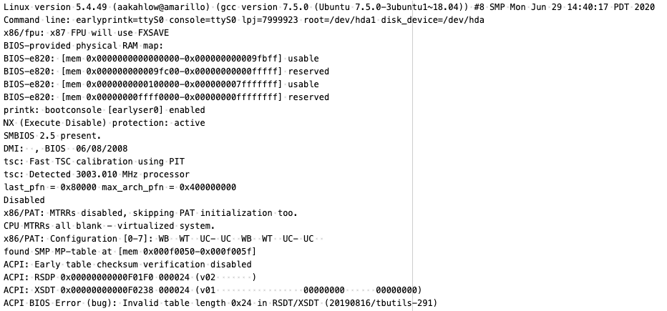
Let’s check other outputs here…
- m5out/
----- board.pc.com_1.device
The terminal output of the simulated system.

Slide 28
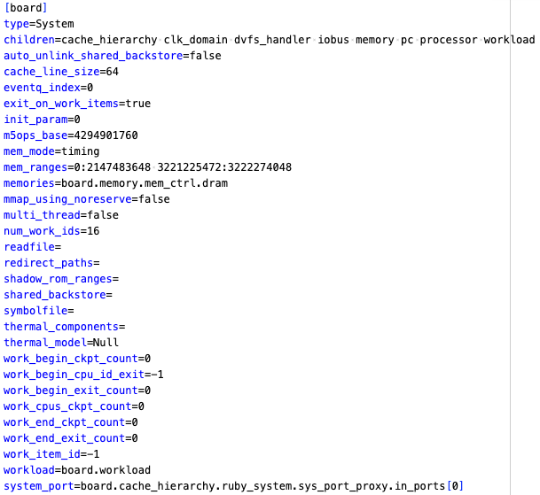
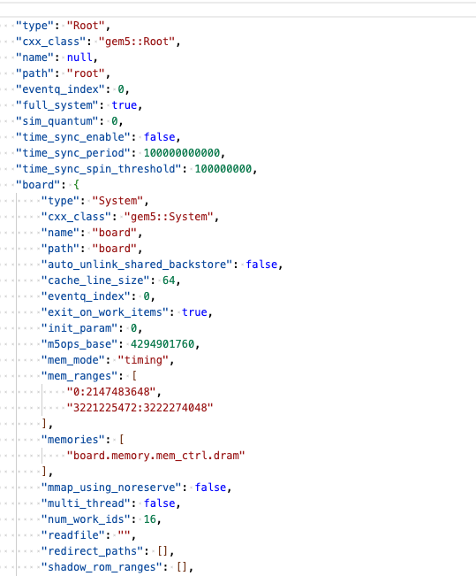
Let’s check other outputs here…
- m5out/
----- board.pc.com_1.device
----- config.{ini/json}
A record of the simulated system in both JSON and INI format.

Slide 29
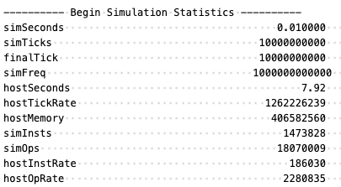
Let’s check other outputs here…
- m5out/
----- board.pc.com_1.device
----- config.{ini/json}
----- stats.txt
The gem5 statistic output

Slide 30
Wait, did we do?
We…
Learned how to clone gem5 and compiled it
Obtained the workload we needed from gem5 Resources
Checked the gem5 output files
Created a simulation using a pre-built board
Checked the gem5 output files

Slide 31
Ok, but how does it all work?
Modern systems are very complex, and the design of gem5 simulations reflects this.
However, at its core, the simulator builds on a relatively simple model.

Slide 32
Nomenclature
Your system
Host: the actual hardware you’re using
Running things directly on the hardware: Native execution
Guest: Code running on top of “fake” hardware OS in virtual machine is guest OS Running “on top of” hypervisor Hypervisor is emulating hardware
App
App
Operating Sys.
Host
Hardware
Virtual machines
App
App
Guest
Operating Sys.
Hypervisor
Host
Hardware

Slide 33
Nomenclature
Your system
Host: the actual hardware you’re using
Simulator: Runs on the host Exposes hardware to the guest
Guest: Code running on simulated hardware OS running on gem5 is guest OS gem5 is simulating hardware
Simulator’s code: Runs natively executes/emulates the guest code
Guest’s code: (or benchmark, workload, etc.) Runs on gem5, not on the host.
App
App
Operating Sys.
Host
Hardware
Simulation
Workload
App
App
Guest
Operating Sys.
gem5/Simulator
Host
Hardware

Slide 34
Nomenclature
Your system
Host: the actual hardware you’re using
Simulator: Runs on the host Exposes hardware to the guest
Simulator’s performance: Time to run the simulation on host Wallclock time as you perceive it
Simulated performance: Time predicted by the simulator Time for guest code to run on simulator
App
App
Operating Sys.
Host
Hardware
Simulation
Workload
App
App
Guest
Operating Sys.
gem5/Simulator
Host
Hardware

Slide 35

At its core: it’s a discrete event simulator
Event at head dequeued
Event executed
More events queued
gem5 is a discrete event simulator
Event Queue
Event - 52
Event - 50
Event - 50
Event - 55
Event - 20
Event - 11
Event - 10

Slide 36
At its core: it’s a discrete event simulator
Event at head dequeued
Event executed
More events queued
gem5 is a discrete event simulator
Event Queue
Event - 51
Event - 55
Event - 52
Event - 50
Event - 50
Event - 20
Event - 11

Slide 37
Discrete event simulation example
Fetch first inst
Miss in L1, send to DRAM
Put in read Q
Get data from DRAM
Cache recvs data
Fetch next inst
Send req to cache
Processor decodes instruction
Processor executes instruction
TIME
L1 tag latency
To DRAM latency
DRAM read latency
Response latency
One cycle

Slide 38
Discrete event simulation
"Time" needs a unit In gem5, we use a unit called "Tick"
Need to convert a simulation "tick" to user-understandable time E.g., seconds
This is the global simulation tick rate Usually this is 1 ps per tick or 10¹² ticks per second

Slide 39
Ok, but how do you schedule these events?
While some are incredibly complex, at their core they only do two things:
SimObject
Schedule events and process events.
2. Talk to other SimObjects.

Slide 40
This is great, but it takes a lot to get things done
gem5
Config file
This allows for maximum flexibility but can mean creating 100s of lines of Python to create even a basic simulation.

Slide 41
What is the standard library for?
gem5
stdlib
Config file
The stdlib is a library which allows for users to quickly create systems with pre-built components.
The stdlib's module architecture allows for components (e.g. a memory system or a cache hierarchy setup) to be quickly swapped in and out without radical redesign.

Slide 42
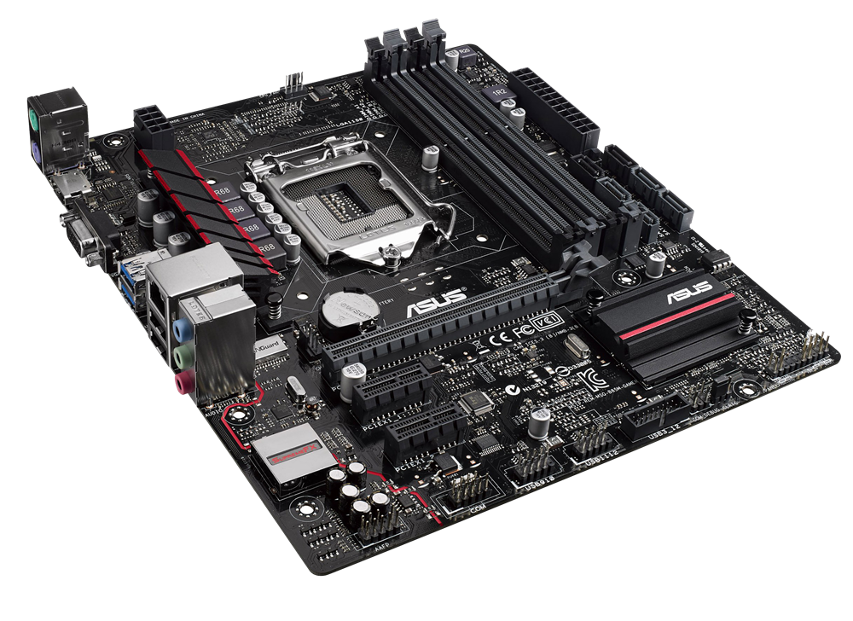
The stdlib modular metaphor
Processor
Simple Processor
Memory
SwitchableProcessor
Cache Hierarchy
SingleChannelDDR3_1600
No Cache
...
PrivateL1PrivateL2
SingleChannelDDR4_2400
MesiTwoLevel
Board
...
...

Slide 43
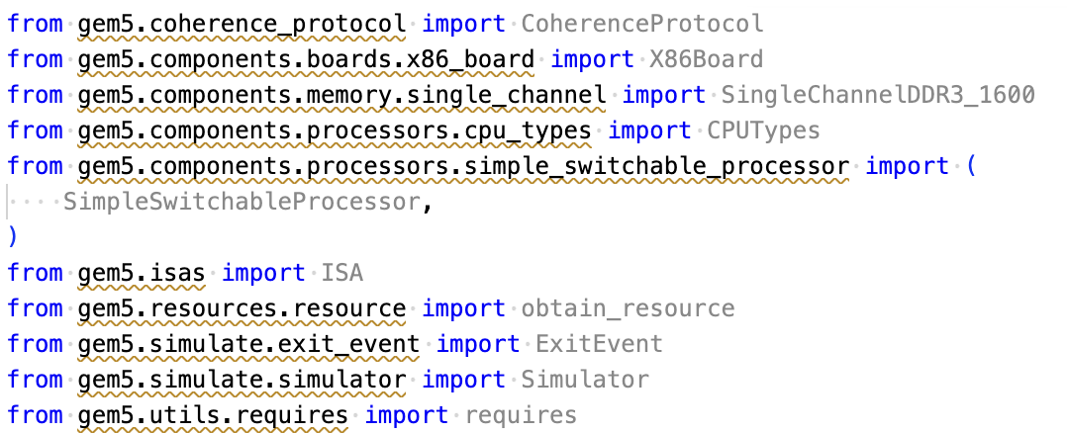
Let’s build using components!
Open “materials/02-components.pyx You’ll see the above already prepared for you.

Slide 44
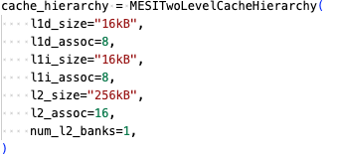
Let’s choose a cache hierarchy and memory system

Slide 45
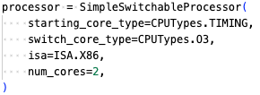
And a processor!
The SimpleSwitchingProcessor allows for different types of cores to be swapped during a simulation with `processor.switch()`.
This can be useful when wanting to switch to and from a detailed form of simulation. More on this alter.

Slide 46
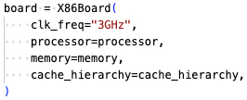
Then let’s plug them into a board
We add the components to the board, in this case an `X86Board`.

Slide 47
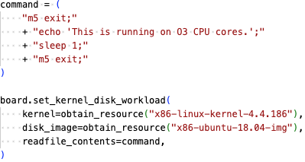
Load in our workload to the board
The `set_kernel_disk_workload` function accepts a kernel binary resources and a disk images resources.
In addition, here we are passing a command via the `readfile_contents` parameter which will run after the boot is complete.
The `m5 exit` command will exit the simulation loop.

Slide 48
Run the simulator
Simulated System
Boot OS
`readfile_contents` executed
1st `m5 exit`
`echo ”This is…”`
`sleep 1`
End of Simulation
2nd `m5 exit`

Slide 49
Run the simulator
> ./build/ALL/gem5.opt materials/02-components.py
A completed version of the configuration can be found in “materials-completed/02-01-components-initial.py”

Slide 50
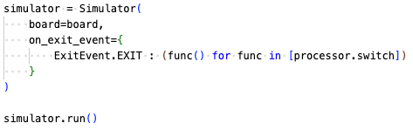
We can do better…
Here we can specify exactly what to do on each exit event type via Python generators.
The Simulator had default behavior for these events, but they can be overridden.
ExitEvent.EXIT
ExitEvent.CHECKPOINT
ExitEvent.FAIL
ExitEvent.SWITCHCPU
ExitEvent.WORKBEGIN
ExitEvent.WORKEND
ExitEvent.USER_INTERRUPT
ExitEvent.MAX_TICK

Slide 51
To run
> ./build/ALL/gem5.opt materials/02-components.py
This will take a while to run but you can see the terminal output in “m5out” while this is running.
Cntr+C to exit the simulation.

Slide 52
What did we just do?
Created and handled exit events
Dumped Statistics for our chosen ROI
A “full-system” simulation
Switch CPU fidelity at a chosen point
The simulations so far are so slow…

Slide 53
gem5 is slloooww
(Not our fault: It’s the natural of simulation)
>> 100k seconds on the host
Simulating 1 Second

Slide 54
Fortunately, there are some work arounds
Key idea: You don’t need to simulate everything perfectly, or at all.
Simulation Fidelity
Simulation Time

Slide 55
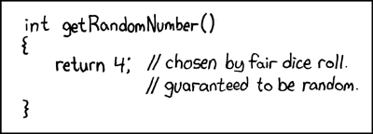
Simulations can always be made faster by simulating less

Slide 56
This isn’t always a bad thing… a lot of a simulation is of no interest to us
Kernel Boot
Wider OS setup
Benchmark application load
ROI
Finish and cleanup
🥱🥱🥱
👀 👀

Slide 57
Some techniques we provide
CPU Models
KVM Mode
SE Mode
Checkpoints
Sampling: Simpoints and Loopoints

Slide 58
SE mode vs FS mode
Host System
Host System
Syscall Emulation Simulation
Full-System Simulation
SE Mode relays application syscalls to host OS. This means we don’t need to simulate an OS for applications to run
In addition, we can access host resources such as files of libraries to dynamically link in.
Application
Application
OS
OS
Hardware
Hardware

Slide 59
SE mode example
A pre-made script which uses SE-mode can be found in “materials/03-se-mode.py”.
It’s very similar to the scripts you’ve created thus far but uses the `SimpleBoard`.
Let’s try to understand the script first before demoing SE Mode. It includes some features we’ve yet to explain.
SE Mode

Slide 60
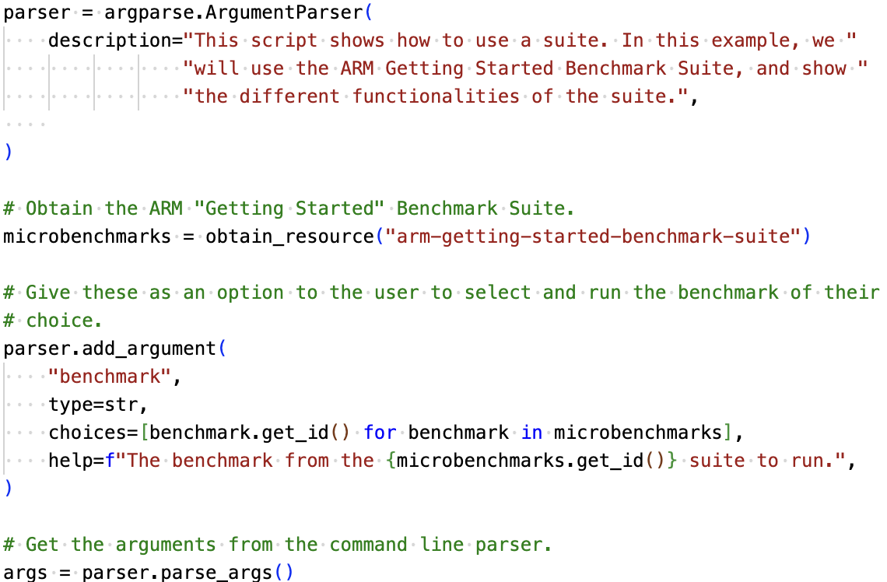
Suites (and argparse)
Notes:
Expand here looking up suites on the website, how you can see their contents, etc.

Slide 61
The require function: Making sure we built the right thing
Notes:
Add more here about the other things we can declare in the `requires` function.

Slide 62
SE mode
> ./build/ALL/gem5.opt materials/03-se-mode.py \
arm-matrix-multiply-run
This will take about a minute to run.
This would’ve taken hours to run in FS, but in SE ignore the entire OS simulation
You can try other CLI options too.

Slide 63
FS and SE mode: Common Fit falls
“FS mode takes too long so I just switched over to SE mode”
You must understand what you’re simulating and whether it’ll impact results.
”gem5 Won’t let me run a binary with elevated instructions”
SE-mode will only allow you to simulate user-space instructions. We can’t just pass elevated instructu
”I can’t run my program in SE-Mode because a syscall isn’t implemented correctly”
We’d love to have all the syscalls implemented but it’s too much work.

Slide 64
FS and SE mode
FS mode does everything SE mode does, and more! When in doubt, or struggling with SE, use FS mode.

Slide 65
CPU Models
Memory Accesses
How memory are simulated
Timing
Atomic
CPU Design
The type of CPU design. The simpler the faster.
O3
Pipeline
Simple
CPU Models
Notes:
Show changing TIMING to atomic in our example and how that may improve things.

Slide 66
CPU Models: Memory Accesses
Atomic Accesses
When a memory is accessed, the CPU gets the data instantly and latency is simply estimated for statistics. I.e., everything is happening in one function call from the CPU, in a single event in the Queue.
Low fidelity but fast!
Only suitable if you don’t care about memory access data (kind of rare for computer architects…).
CPU Models
Notes:
Show changing TIMING to atomic in our example and how that may improve things.

Slide 67
CPU Models: Memory Accesses
Timing Accesses
Memory requests are responded to by scheduling events in the future in the event queue.
I.e., a request is made by the CPU to memory and the response is scheduled in the event queue.
Low but more accuarate.
CPU Models
Notes:
Show changing TIMING to atomic in our example and how that may improve things.

Slide 68
CPU Models: Simple
CPU Models
Simple CPU
A basic in-order CPU model. Due to its relative simplicity, it is relatively easy to simulate compare to other CPU model types.
Notes:
Show changing TIMING to atomic in our example and how that may improve things.

Slide 69
CPU Models: Simple
CPU Models
Minor CPU
A CPU model for simulating pipelines. The Minor CPU is highly configurable.
Notes:
Show changing TIMING to atomic in our example and how that may improve things.

Slide 70

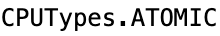

Let’s play around with a few different CPU models
Go back to the “materials/03-se-mode.py script.
Try changing the `cpu_type` field of the `SimpleProcessor` and see how it impacts simulation execution time (see ‘host seconds; in “m5out/stats.txt” for this information
A Simple CPU using the Timing memory access model.
A Simple CPU using the Atomic memory access model.
A O3 CPU using the Timing memory access model.

Slide 71
What I observed with matrix-multiply

Slide 72
KVM Mode: The other special CPU Type
The KVM CPU utilizes the host systems Kernel Virtual Machine to utilize the host hardware to execute instructions.
The host must have KVM enabled and be of the same ISA type as that being emulated.
KVM always runs with Atomic memory accesses. It is simulating almost nothing and is therefore very fast.
Due to GitHub Codespace restrictions, we cannot use this special CPU type.
If you later wish to check your host system’s compatibility and how to setup KVM see: https://www.gem5.org/documentation/general_docs/using_kvm/
Notes:
Demo KVM mode (if I can)

Slide 73
Checkpointing
Checkpointing allows for a simulation to save its state then load to that state later.
This is useful in cases where you want to quickly jump to points in .
This is literally like a checkpoint/save in a video game.
The simulated system that restores the checkpoint can differ from that which created it. There are some restrictions:
1. You can’t restore to a system with less memory.
2. You can’t restore with a different workload.
3. Ruby Cache Hierarchy’s are wiped. Ergo you start with a clean cache from restore.

Slide 74
Saving a Checkpoint
Open “materials/04-01-saving-a-checkpoint.py”.
Let’s first go through the file to understand what this configuration is doing.

Slide 75
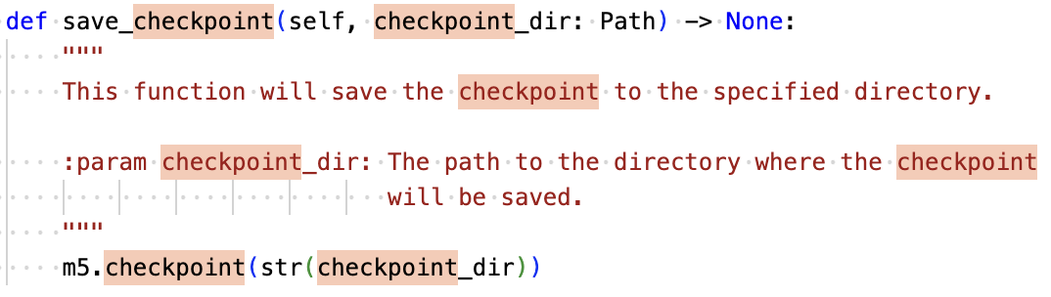
Saving a Checkpoint
This is a function definition in “src/gem5/python/simulate/simulator.py”. Using this info, append to the configuration file to make it create a checkpoint after the first `m5 exit`.
When done, run the script. It should take about 20 minutes.

Slide 76
Saving a Checkpoint
Don’t worry, I’ve created one for you: “materials-completed/checkpoints/04-01-saved-checkpoint”

Slide 77
Restoring from a checkpoint
Open “materials/04-02-saving-a-checkpoint.py”.
Again, let’s go through this file. Note the differences.
This file is complete. Run it and see the restore in action.

Slide 78
Sampling!
Sampling is only simulating small parts of an execution then extrapolating data from there.
SimPoint and Looppoint are partially integrated into gem5.
There are some toy examples in “configs/example/gem5_library/looppoints”.
Sampling
Right now, a bit experimental.
Advanced users only!

Slide 79
You can now
Obtain, compile, and run gem5
Understand Event-based Simulation
Understand SE and FS mode
Setup simulations
using the gem5 stdlib
Use Exit Events to return data and alter parameters at specific points in time
Reduce your simulation time with a set of tricks to lower and increase fidelity

Slide 80
What’s next?
While we strive to provide a tool which allows for easy simulation of typical hardware setups via modular connections between components provided by the project…
Research and development requires creation of something new. We must therefore know how to create new components, simobjects, and incorporate them into our designs.
We provide you with 99% of a simulated system so you can fuss over that 1% that’s unique to your project

Slide 81
SimObjects at a glance
Model C++ code in src/
Parameters Python code in src/ In SimObject declaration file
Instance or configuration A particular choice for the parameters In standard library, your extensions, or python runscript

Slide 82
Adding a new SimObject
Step 1: Create a Python class (SimObject description file)
Step 2: Implement the C++
Step 3: Register the SimObject and C++ file
Step 4: (Re-)build gem5
Step 5: Create a config script

Slide 83
Adding a new SimObject
Create a new directory in “src” called ”simobject-example”.
All the files will go there.

Slide 84
Step 1: Create a Python class
HelloObject.py
m5.params: Things like MemorySize, Int, etc.
| from m5.params import *
| from m5.SimObject import SimObject
|
| class HelloObject(SimObject):
| type = ”HelloObject"
| cxx_header = ”simobject-example/hello_object.hh"
| cxx_class = "gem5::HelloObject"
Import the objects we need
type: The C++ class name
cxx_header: The filename for the C++ header file
cxx_class: The fully qualified C++ class name

Slide 85
Step 2: Implement the C++
hello_object.hh
params/*.hh generated automatically. Comes from Python SimObject definition
| #include "params/HelloObject.hh"
| #include "sim/sim_object.hh”
| namespace gem5{
| class HelloObject : public SimObject
| {
| public:
| HelloObject(const HelloObjectParams &p);
| };
| } // namespace gem5
Constructor has one parameter, the generated params object. Must be a const reference
PARAMS is a macro to convenience to typedef Params for this object

Slide 86
Step 2: Implement the C++
HelloObjectParams: when you specify a Param in the Hello.py file, it will be a member of this object.
hello_obj.cc
#include ”simobject-example/hello_object.hh”
#include <iostream>
HelloObject::HelloObject(const HelloObjectParams &params) : SimObject(params)
{
std::cout << "Hello World! From a SimObject!" << std::endl;
}

Slide 87
Step 3: Register the SimObject and C++ file
Import: SConscript is just Python… but weird.
SConscript
| Import('*')
| SimObject(HelloObject.py', sim_objects=[HelloObject'])
| Source(hello_object.cc')
SimObject(): Says that this Python file contains a SimObject. Note: you can put pretty much any Python in here
Source(): Tell scons to compile this file (e.g., with g++).
sim_objects: The SimObjects declared in the file (could be more than 1)

Slide 88
Step 4: (Re-)build gem5
> scons build/ALL/gem5.opt –j`nproc`

Slide 89
Step 5: Create a config script
| import m5
| from m5.objects import *
| root = Root(full_system=False)
| root.hello = HelloObject()
|
| m5.instantiate()
| exit_event = m5.simulate()
| print(f"Exiting @ tick {m5.curTick()} because" | "{exit_event.getCause()}")
All simulations require a Root
Instantiate the new object that you created in the config file (e.g., simple.py)
Simulate the system as configured!
> build/ALL/gem5.opt run-hello.py
...
Hello world! From a SimObject!
...
Instantiate all the SimObjects (create the C++ instances)
Notes:
Not there’s a completed example here under “materials-completed/05-creating-simobject"

Slide 90
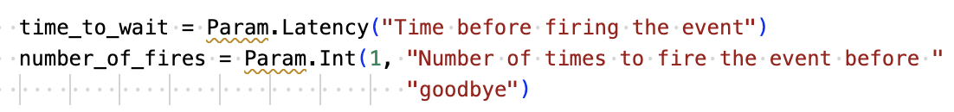
Adding Parameters and events to the SimObject
Add this to “HelloObject.py”.
This declares the parameters of the SimObject.

Slide 91
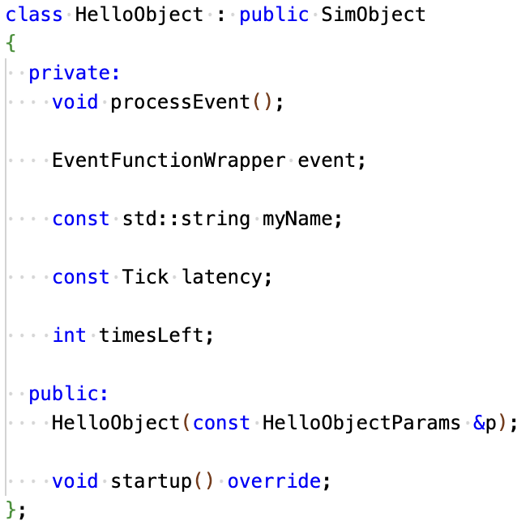
Adding Parameters and events to the SimObject
Update the “hello_object.hh” with the parameters and the event variables/functions.
The “processEvent” function will handle the event.
The “event” variable will wrap the “processEvent’ function.
The other variables store the stage of the object and the variables
Notes:
Note the audience here that

Slide 92
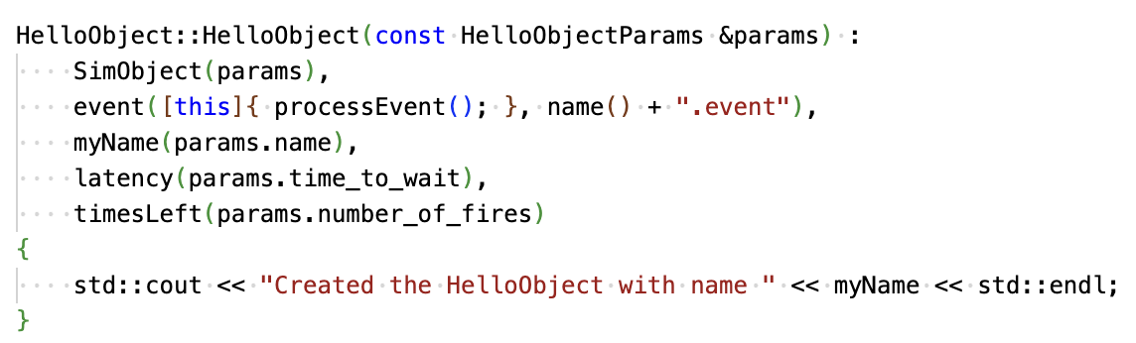
Adding Parameters and events to the SimObject
Now we updated ”hello_object.cc” to set the variables and functions.
We’ve also changed the `std::cout` to output the Object name.

Slide 93
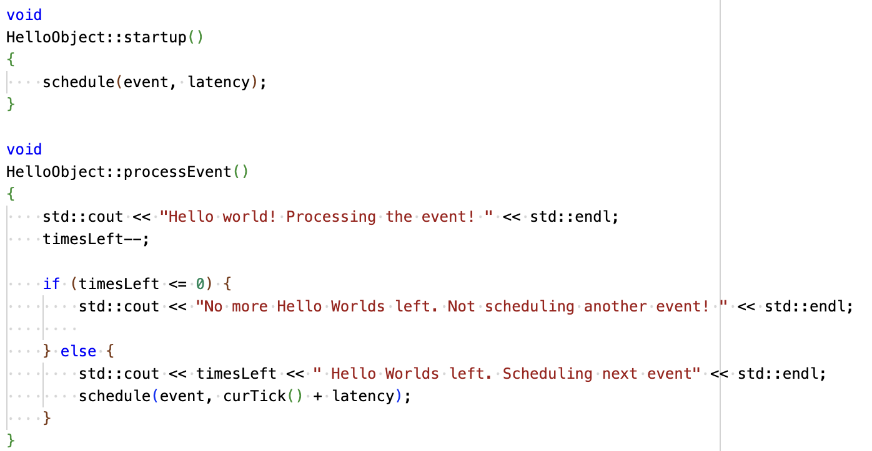
Adding Parameters and events to the SimObject
Implement the `startup` and `processEvent` functions in ”hello_object.cc”
The `startup` schedules the event before the simulation starts with ‘latency`.
The `processEvent` will continue to reschedule the event `timeLeft` times.

Slide 94
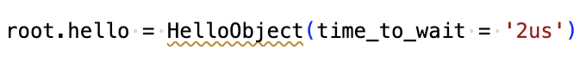
Adding Parameters and events to the SimObject
Because `time_to_wait` does not have a default value we must set it in the config script.
Add this to your run script.

Slide 95
Adding Parameters and events to the SimObject
scons build/ALL/gem5.opt –j`nproc`
./build/ALL/gem5.opt <your run script>
After, why don’t you try running changing the default `number_of_fires` parameter to something more interesting.

Slide 96
A little more to do in your own time
https://www.gem5.org/documentation/learning_gem5/part2/parameters/ contains an additional part of this tutorial which involves adding another SimObject: “GoodbyeObject” which schedules a Goodbye event when the HelloObject events cease scheduling
If your interested in SimObjects and creating your own this is worth doing..

Slide 97
Let’s see how SimObject objects are configured, utilized and create new components
Let’s do it live! Try to follow along!
(an example can be found in “materials-completed/05-our-silly-cache”)
Notes:
Go through through showing how the Cache is setup from BaseCache and eventually up the PrivateL2CacheHierarchy component.

Slide 98
gem5 Resources
A resources is something that runs on a simulated system.
While the underlying simulated hardware remains the same, what resources are used in the simulation impact what the simulated system runs and how the simulator runs it.
Typically, this is software, disk images, or data to be loaded into the simulated system’s memory/storage.
It may also be things like “checkpoints” for the simulation to use, or sampling data.
They are files, directories, programs, and generally thing that doesn’t impact a simulated configuration but does impact it’s running.

Slide 99
Contributing to gem5
You’ve learned a thing or two about gem5, why not work to make it better?

Slide 100
Our Strategy
Learn
More interest
Use
Improve
Develop
Contribute
Notes:
We want to teach people how to use gem5 so they use gem5.
People who use gem5 will want to extend gem5.
We hope those people who create useful extensions will contribute
Learn -> Use -> Develop -> Contribute -> Make gem 5 better -> More interest -> Learn

Slide 101
Why should I contribute to gem5?
You’re Nice!
You’ve found a bug and have a fix.
You’ve developed something useful and want to share it.
Fame!
Get yourself known in the project.
Good PR for your research to have it incorporated in gem5.
Fortune!
Looks good on your CV.
Companies contribute to gem5 all the time.
Notes:
You want to be a good citizen
You’ve found a bug and have a fix.
You’ve got a useful feature you think will be of benefit.
Fame
Looks good to have contributed to an open source project.
Some cool architectural concept will get more interest in the community if they can be easily simulated in gem5
Fortune
Your company may use gem5 as a critical tool, by engaging in development you can make your company better.

Slide 102
“I’m scared”
Understandable…
Very few patches get in straight away. Most patches are only accepted after requests for changes.
We try our best to keep feedback as constructive as possible (don’t take it personally!).
The purpose of this session is to make it less scary!
Notes:
Yes, it’s scary
Very few patches get in “straight away”, most patches submitted will receive feedback and requests for changes before accepting them
We try our best to keep negative feedback as constructive as possible
The purpose of this session is to make it all less scary for you.

Slide 103
What can I contribute?
Your own changes (bug fixes are very welcome!)
Check the GitHub Issue Tracker:
https://github.com/gem5/gem5/issues
Some stuff we’re always needing more of:
Tests
Incorporating Syscalls for SE mode
Unimplemented ISA instructions/extensions
Useful stdlib components
Useful gem5 resources
Updating documentation on the gem5 website
Even fixing typos is helpful!
Notes:
Your own changes (bug fixes very welcome)
Check the Jira
Some things we’re always needing more of:
More tests!
Incorporation of Syscalls for SE mode
Unimplemented ISA instructions/extensions
Useful stdlib components
Useful gem5 resources

Slide 104
What can’t I contribute?
Anything that’ll burden the community with too much maintenance overhead.
Yeah, you’ve developed something nice for us, but it’s big and complex: are you going to stick around to help us maintain it? Is it engineered for that to be easy?
2. Something overly niche and lacks general applicability
The component you made to carry out your research may be interesting to you but adding it to the codebase may just be bloat to most users: Consider sharing such things on your own git repos.
3,.It’s dangerous
You’ve changed a lot of code and haven’t proven you’ve not yet broken anything. Tests are required at a minimum.
3. It doesn’t confirm to our standards
The code appears fine, but you’ve not conformed to our style guide.
Notes:
Your own changes (bug fixes very welcome)
Check the Jira
Some things we’re always needing more of:
More tests!
Incorporation of Syscalls for SE mode
Unimplemented ISA instructions/extensions
Useful stdlib components
Useful gem5 resources

Slide 105
Forking and cloning
Step 1: Go to https://github.com/gem5/gem5
Step 2: Fork the repo
Step 3: Clone the forked repo
Notes:
Note: They don’t need to clone and explain why switch from develop then “my-change” is necessary.

Slide 106
Where do I make changes?
>git switch develop
>git switch –c my-change
Notes:
Note: They don’t need to clone and explain why switch from develop then “my-change” is necessary.

Slide 107
Making changes: CPP
Full style guide here: https://www.gem5.org/documentation/general_docs/development/coding_style/
High-level overview: https://www.gem5.org/contributing#making-modifications
Doxygen is highly recommended
http://doxygen.gem5.org
Notes:
Discuss here an example to make a CPP file, emphasize the style guide and point towards resources.
Discuss leaving a comment and the Doxygen website

Slide 108
Making changes: Python
> pip install black
> black <python file>
For variable/method/etc. Naming conventions please follow the PEP 8 naming convention recommendations: https://peps.python.org/pep-0008/#naming-conventions
While we try to enforce naming conventions across the gem5 project, we are aware there are instances where they are not.
In such cases please follow the convention of the code you are modifying.
Notes:
Discuss here an example to make a Python file, emphasize the style guide, show how to make good comments.

Slide 109
The biggest gotchas!
Whitespace at the end of a line.
Indentation not 4 space characters (please, no tabs)
Lines too long (for CPP, no more than 79 characters!)
When in doubt, follow the style around you!
We have a style checker which should stop you committing if you’ve done something wrong, but it’s not perfect and can be side-stepped.
Notes:
Discuss here an example to make a Python file, emphasize the style guide, show how to make good comments.

Slide 110
Ensure pre-commit is installed
> ./util/pre-commit-install.sh
Pre-commit ensures when you are about to commit a change a series of checks are run on your code to ensure it conforms to our style guide
Notes:
Discuss here an example to make a Python file, emphasize the style guide, show how to make good comments.

Slide 111
Using git
> git add <files to add>
> git commit

Slide 112
Commit message rules
We have some unique rules for gem5:
The header must lead with tags (see MAINTAINERS.yaml for a list of tags).
Headers should be clear, short descriptions of what a patch will do.
Headers should be no longer than 65 characters
A blank line separates the header and the patch description.
Descriptions can span multiple paragraphs but lines should not exceed 72 characters (this is lax rule, it’s acceptable to exceed this if you’re quoting code, or including a URL).

Slide 113
View the Git Log
> git log

Slide 114
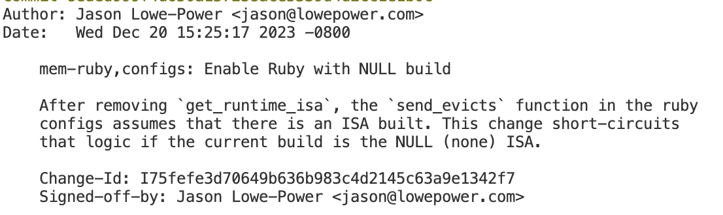
Example commit message

Slide 115
How do I push?
> git push
This pushes to your forked repo

Slide 116
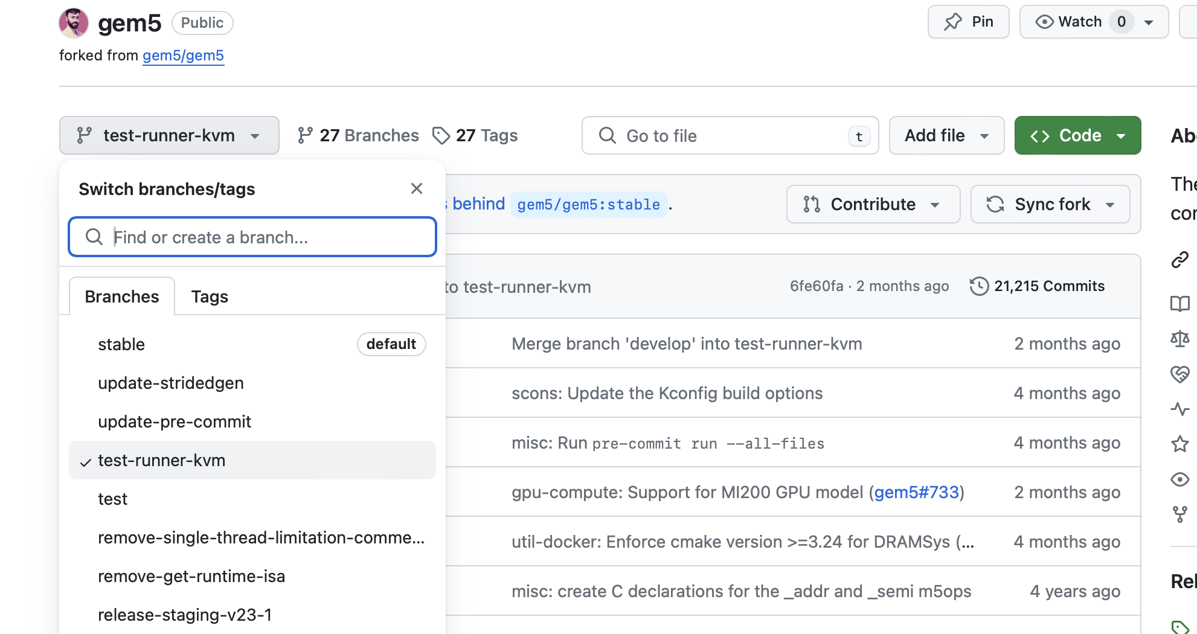
Create a pull request
Select the branch you just pushed

Slide 117
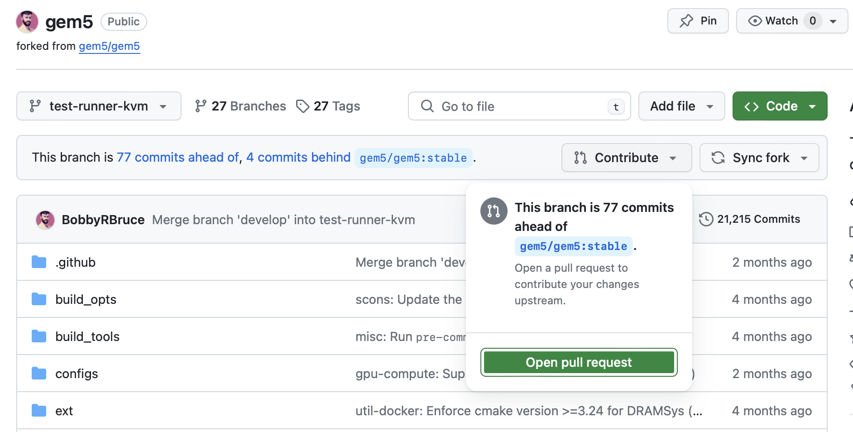
Create a pull request
Click “Open Pull Request” under “Contribute”

Slide 118
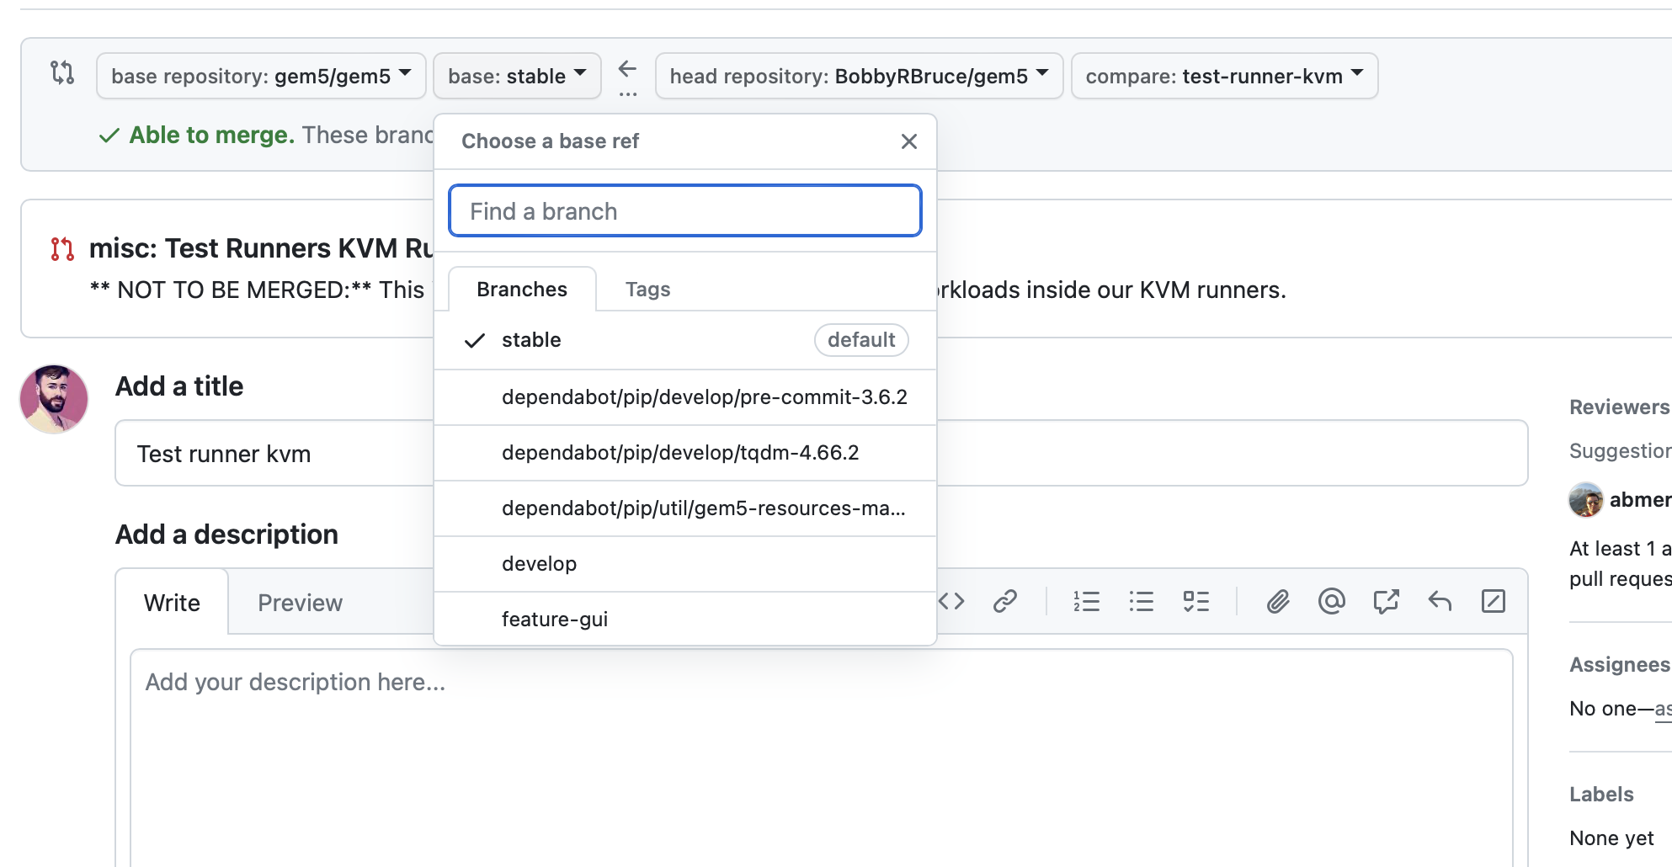
Create a pull request
Fill out the form. Of note: Change the base branch to “develop”.
Once filled, click “Create Pull Request”

Slide 119
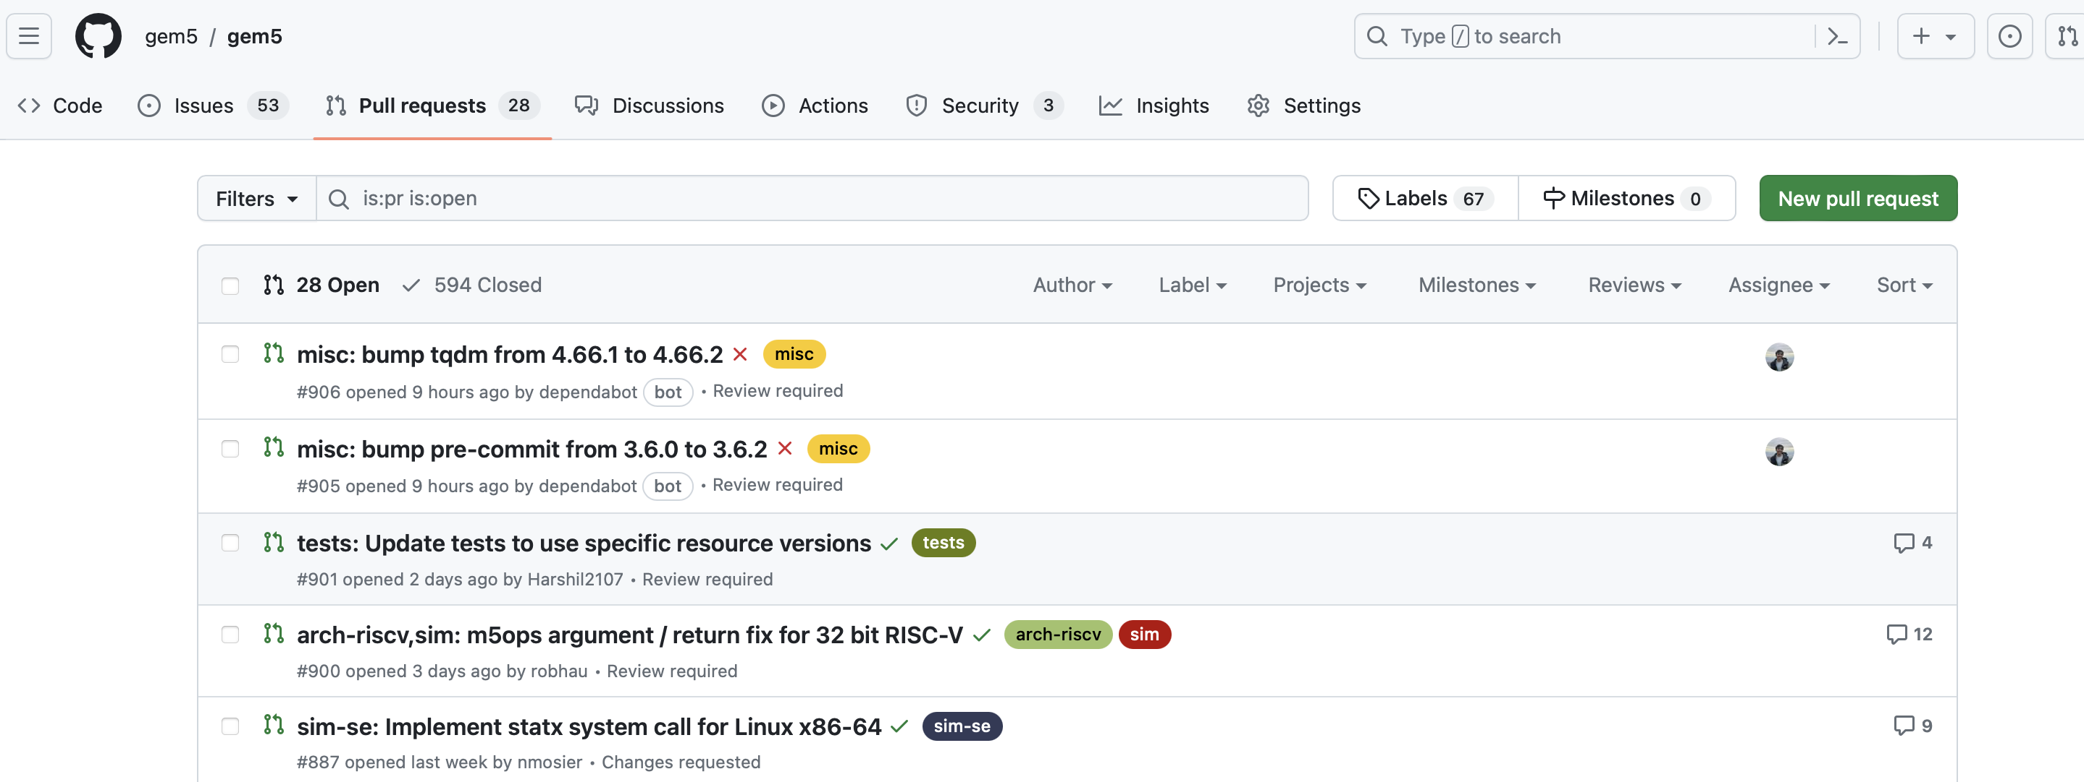
Pull Request waiting for testing and review
https://github.com/gem5/gem5/pulls

Slide 120
PR Review Process
PR Created
Wait for Tests to complete
Tests Pass?
No
Update change
Refuses (rare)
Yes
Maintainer Decides if to merge Change
PR is reviewed by community member.
Approve
Suggestions made
To make changes just push to your forked repo branch!
Yes
PR Merged
Notes:
Your own changes (bug fixes very welcome)
Check the Jira
Some things we’re always needing more of:
More tests!
Incorporation of Syscalls for SE mode
Unimplemented ISA instructions/extensions
Useful stdlib components
Useful gem5 resources

Slide 121
Testing overview
CI Tests
The most direct are the “CI Tests”, you cannot merge your change into develop without these passing on your PR.
The rest run either daily or weekly. It is therefore possible your PR breaks gem5 but there’s a delay in us finding out (so keep an eye on these tests).
Daily Tests
Execution time
Compiler Tests (Run Weekly)
Weekly Tests
Badges are shown on the repo main page: https://github.com/gem5/gem5?tab=readme-ov-file#testing-status
Notes:
Your own changes (bug fixes very welcome)
Check the Jira
Some things we’re always needing more of:
More tests!
Incorporation of Syscalls for SE mode
Unimplemented ISA instructions/extensions
Useful stdlib components
Useful gem5 resources

Slide 122
What about the other gem5 repos?
gem5 Website
https://github.com/gem5/website
The www.gem5.org sources.
Changes made to the “stable” branch are live.
Changes made to “develop” will be merged into stable on the next gem5 release.
gem5 Resources
https://github.com/gem5/gem5-resources
The Sources for the gem5 Resources
Build atop “stable” to make changes for the current release.
Built atop “develop” to make changes for the upcoming release.
Neither of these are held up to the same standards as the gem5 repo but changes to them are reviewed.

Slide 123
Some useful resources
https://www.gem5.org/contributing
CONTRIBUTING.md in the gem5 directory
Sometimes using git is the biggest hurdle:
https://git-scm.com/book/en/v2 : The git book
https://dev.to/milu_franz/git-explained-the-basics-igc : I think this is a good tutorial but is very GitHub-centric (we don't use GitHub for gem5). Still, going through it would be beneficial.
https://wiki.spheredev.org/index.php/Git_for_the_lazy : Does a quick run through of the basic Git commands. Can be good for reference.
http://marklodato.github.io/visual-git-guide/index-en.html: A bit more complex but tries to introduce the git data structures involved in git
https://towardsdatascience.com/git-help-all-2d0bb0c31483: Another resource outlining both the commands and explaining how git works.

Slide 124

Caveats
gem5 is a tool, not a panacea
Most models are not validated against “real” hardware
“All models are wrong but some are useful”
See “Architectural Simulators Considered Harmful”by Nowatzki et al. (2015).
There are bugs!

Slide 125
Bobby’s Advice
Learn git. By that, I mean beyond “git add” and “git commit”.
Get comfortable with Object Oriented design. The gem5 codebase depends heavily on it. Learn it and incorporate it in your work.
Don’t modify, extend! Hacking what’s already there will cause problems. Create new SimObjects, components, scripts as needed.
Understand the data you need before trying to make gem5 go faster. SE mode, checkpoints, faster CPU models etc. are tempting but they have trade-offs.
Do not configure your system via the command line: Configurations exist in your configuration file and associated components, SimObjects, etc.

Slide 126
References
Martin et al. 2005. Multifacet’s general execution-driven multiprocessor simulator (GEMS) toolset. ACM SIGARCH Computer Architecture News. https://doi.org/10.1145/1105734.1105747
Binkert et al. 2006. The M5 simulator: Modeling Networked Systems. IEEE Micro. https://doi.org/10.1109/MM.2006.82
Binkert, et al. 2011. The gem5 simulator. SIGARCH Comput. Archit. News 39 http://dx.doi.org/10.1145/2024716.2024718
Lowe-Power et al 2021. The gem5 Simulator: Version 20.0+. ArXiv Preprint ArXiv:2007.03152, 2021. https://doi.org/10.48550/arXiv.2007.03152
Nowatzki et al. 2015. Architectural simulators considered harmful. IEEE Micro. https://doi.org/10.1109/MM.2015.74

